Slide 1

ACADEMIC WRITING
WEEK 8
NORLIDA ARIFFIN

Slide 2
Present clear and convincing evidence.
Strong essays consist of reasons supported by evidence. Reasons can be thought of as the main points supporting your claim or thesis. Often they are the answers to the question, "Why do you make that claim?" An easy way to think of reasons is to see them as "because phrases." In order to validate your reasons and make your argument successful, support your reasons with ample evidence.
Forms of evidence:
facts
statistics
authorities
anecdotes
scenarios
cases
textual evidence

Slide 3
In addition, you should check criteria for the validity of your information:
Accuracy
Credibility of sources
Timeliness
Objectivity or bias
Reliability

Slide 4
Signposting sentences
Signposting sentences explain the logic of your argument. They tell the reader what you are going to do at key points in your assignment. They are most useful when used in the following places:
In the introduction
At the beginning of a paragraph which develops a new idea
At the beginning of a paragraph which expands on a previous idea
At the beginning of a paragraph which offers a contrasting viewpoint
At the end of a paragraph to sum up an idea
In the conclusion

Slide 5
Signposting for an introduction
To understand the role of ... (your topic) this essay aims to provide a discussion of ... (the ideas you will develop)
This essay seeks to investigate/evaluate/illustrate/discuss the impact of ... (your topic) in relation to ... (the ideas you will develop)
This essay examines ... (your topic) and its links with ... (your first idea). Next, it closely examines ... in relation to ... (your next idea). Finally, it focuses on ... and how this affects ...(your next idea)

Slide 6
Signposting for a paragraph which introduces or develops a new idea
One aspect which illustrates ... (your topic) can be identified as ... (the idea you want to develop)
The current debate about ... (your topic) identifies an interesting viewpoint on ...(the idea you want to develop)
This first/next/ final section provides a general discussion of ...(the idea you want to develop)

Slide 7
Signposting for a paragraph which expands upon a previous idea
Building on from the idea that ... (mention previous idea), this section illustrates that ... (introduce your new idea).
To further understand the role of ...(your topic or your previous idea) this section explores the idea that ... (introduce your new idea)
Another line of thought on ... (your topic or your previous idea) demonstrates that ... (introduce your new idea)

Slide 8
Signposting for a paragraph which offers a contrasting view
However, another angle on this debate suggests that ... (introduce your contrasting idea)
In contrast to evidence which presents the view that ... (mention your previous idea) an alternative perspective illustrates that ... (introduce your contrasting idea)
However, not all research shows that ... (mention your previous idea). Some evidence agrees that ... (introduce your contrasting idea)

Slide 9
Signposting to sum up an idea in a paragraph
This evidence highlights that ... (sum up your idea)
There is general agreement that ... (sum up your idea)
The strength of such an approach is that ...(sum up your idea)

Slide 10
Signposting stems for a conclusion
As a conclusion, this essay has shown that the main factors which impact upon ... (your topic) are ...(summarise your main ideas)
In conclusion, the evidence presented in this assignment has shown that ... (mention the conclusions you have drawn)
To conclude, this assignment has addressed a number of significant issues which show that ... (mention the conclusions you have drawn)

Slide 11
Examples of signposts that are used in argumentative essays
When pointing out opposing arguments (Cons):
Opponents of this idea claim/maintain that…
Those who disagree/ are against these ideas may say/ assert that…
Some people may disagree with this idea,
Some people may say that…however…

Slide 12
When stating specifically why they think like that:
They claim that…since…
Reaching the turning point:
However,
On the other hand,

Slide 13
When refuting the opposing idea, you may use the following strategies:
compromise but prove their argument is not powerful enough:
They have a point in thinking like that.
To a certain extent they are right.
completely disagree:
After seeing this evidence, there is no way we can agree with this idea.
say that their argument is irrelevant to the topic:
Their argument is irrelevant to the topic.

Slide 14
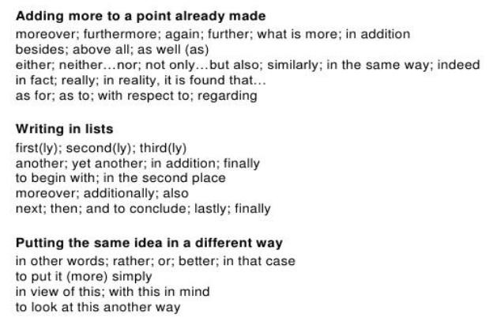

Slide 15
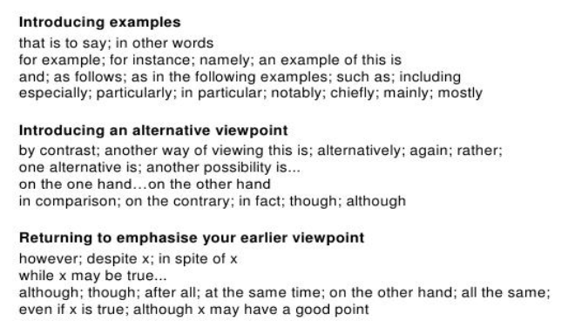

Slide 16
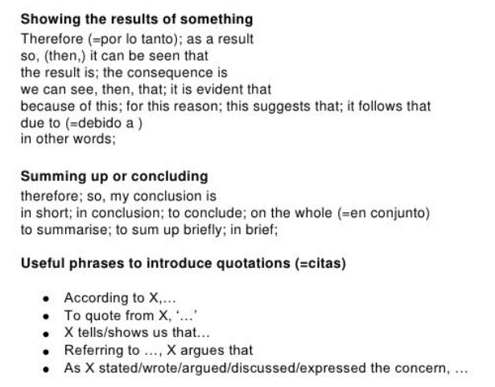

Slide 17
Group work
Based on the topic assigned, each group has to come out with:
2 main points to support your side
Provide facts/ supporting evidence to back up your points
Provide at least 1 citation for each main point
1 counter argument and refute the claim + 1 citation

Slide 18
Group work
Are men and women equally emotional?
Are parents responsible for childhood obesity?
Do you think that college should be free?
Do you think that all internships should be paid?
Is a degree from an online college or university as legitimate as a degree from a brick-and-mortar university?

